Slide 1

C-Man (Canteen Management System)

Slide 2

Track Item consumption of Food for settling the Contractor Bill
Provides Data for Canteen Food Planning to reduce Food wastage, in case of Company owned Canteen.
Calculates the Meal being availed.

Slide 3

Completely Automated Canteen process.
Software for process the Order Items
System to generates Various Types of Consumption Report
User data are send to payroll / Billing Software for Further Process

Slide 4
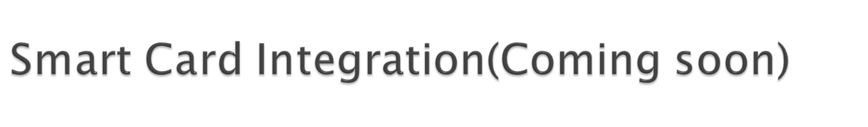
There are some companies who may want to define the Meal allowance to the Employee at the beginning of each month based on their Grade or nature of work, for a Pre-paid kind of Infrastructure.
A Smart Card may be issued in this case. It will be loaded, by Company’s Administration, with the Count/Points(equivalent to Monetary transaction). This may be traded against the Meal Booking.
The Count/Points to be deducted against Each Meal is defined once as part of the configuration of Terminal, while setting up the System.
The Employee has to use their Card in either of the above mode(Current or Advance), after the Finger Punching. The pre-loaded value is checked before the Coupon printing (i.e. before committing) & is respective value is deducted based on the Meal Selection.
It may be very useful for controlling the Meal allowance for better Company resource Planning.

Slide 5
Modules:-
LOGIN
ADMIN MODULE
EMPLOYEE MODULE
View Employee/Stock
Remove Stock
Add/Remove New Employee/Stock
View Employee
View Margin

Slide 6
Software Requirements:-
SOFTWARE REQUIREMENTS:
  Frontend: HTML (version 5) + CSS (version 3.0)
  JavaScript
  Bootstrap
SERVER:-
  Coding: PHP (version 7.0.1)
  Database: MySQL(Backend)
  Local Web Server: Apache (version 5)

Slide 7
Reports
Customer will get the consumption MIS Report for the employees consumed food per day, per month. It will be provided in to the admin, in case the deduction is applicable from the salary.
Reports:
Daily Consumption Report Summary for Each Meal for planning/settlement
Daily Transaction Report for Each Meal type with Employee Details
Monthly Employee based Summary

Slide 8

Export Reports in Various File Formats
PDF
MS Excel
Text File for each Transaction for onward integration with Payroll Software

Slide 9
Conclusion:-
The Canteen Management System is a web-based application designed to streamline the process of maintaining the services which is used in the canteen. By incorporating PHP for back-end logic, HTML for structure, and CSS for styling, we have successfully created an intuitive and user-friendly interface.

Slide 10

Gaurav Prajapati
Anmol Dubey
2200290140032/61

